Slide 1
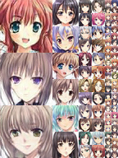
GAN Versus: Anime Faces
Chenxi, Minh and Sheng Kai

Slide 2
Overview
Motivation
Generative Adversarial Networks (GAN)
Dataset
Experimentation and Results
DCGAN
StyleGAN
Comparison
Wrap-Up
Appendix

Slide 3
Motivation
Why did we choose this project?
Implement GAN
Understand the difference between GANs
What are the application of GAN?
Generate artificial data (extend from 2,000 original to 100,000)
Generate similar style images (Cartoon, Anime)
Generate photorealistic images (Animal, People)

Slide 4
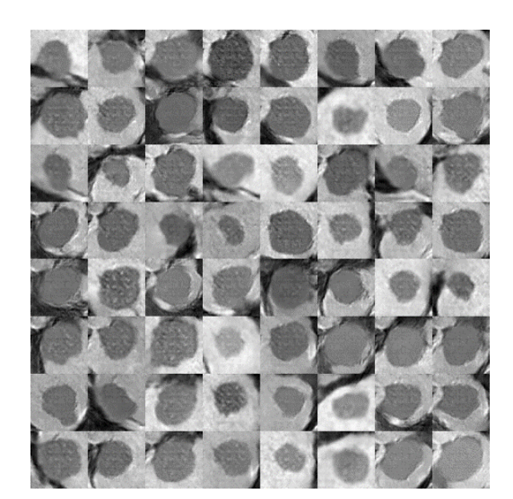
Motivation
Use DCGAN in data augmentation (Khoshgoftaar et al., 2019)
e.g. Medical imaging for liver lesion classification (Frid-Adar et al.,2018)
Synthetic liver lesion ROIs generated with DCGAN
Notes:
DCGAN or any GAN in general

Slide 5
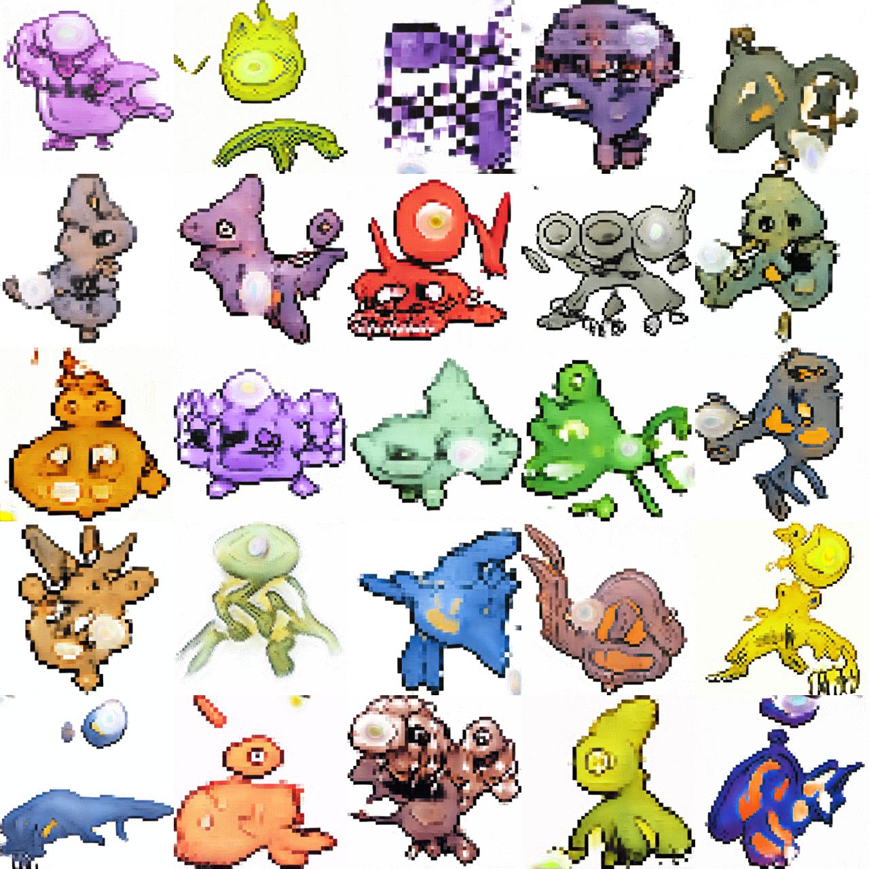
Motivation
Industrial Applications
e.g. Generating animation models
Image credit: Michael Friesen

Slide 6
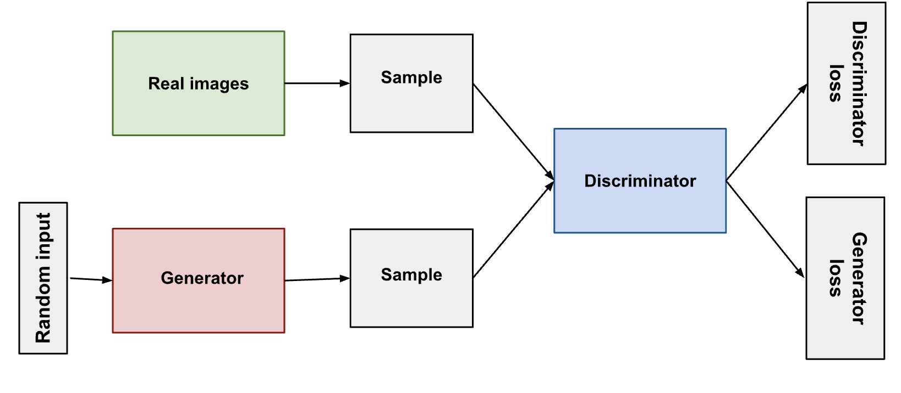
Traditional GAN
A Minimax Game: Generator (G) versus Discriminator (D)
Shortcoming: No control of the style of what the generator generates
Image credit: Google

Slide 7
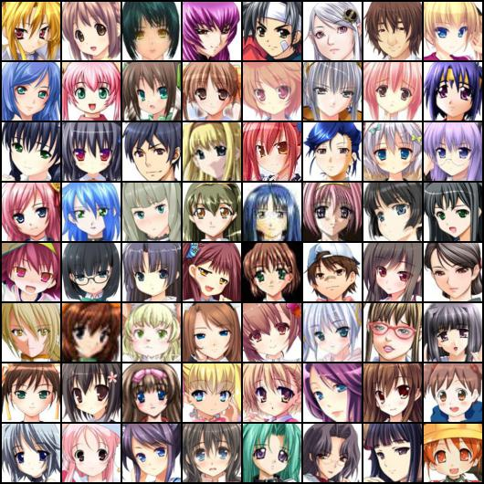
Dataset
63,632 anime faces
Image sizes: 60 x 60 ~ 120 x 120
Different poses, hair, color, year

Slide 8
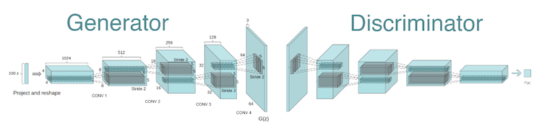
DCGAN

Slide 9
DCGAN Method and Model
Notes:
In DCGAN, Both the generator and the discriminator are neural networks. The generator output is connected directly to the discriminator input. Generally speaking, DCGAN was designed to improve the quality of generation of the original GAN method.

Slide 10
Result and Analysis
Inter-model comparison
Learned features
Loss of Generator and Discriminator in training

Slide 11
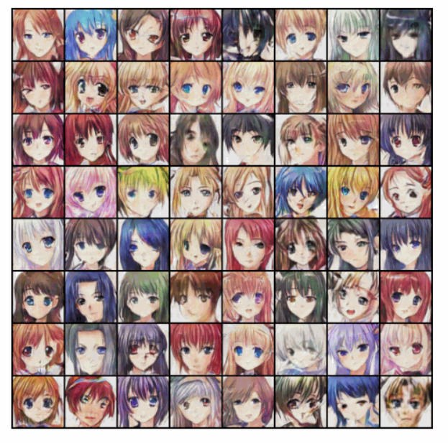
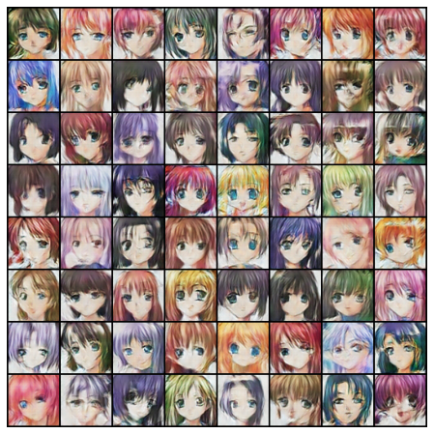
Inter-model Comparison
50 epoch with full dataset
50 epoch with shrinked dataset (19000 images)
Notes:
We trained the DCGAN with the full and shrinked dataset on 50 epochs each, while holding the rest of parameters the same.
With the shrinked dataset, the models did a fair job capturing the major attributes. Such as hair color/style, eyes, face contour. However, it has many artifacts such as the distortion of faces.
In contrast, using the full dataset, the model not only learns those attributes, but also represents them more accurately and generates less artifacts

Slide 12
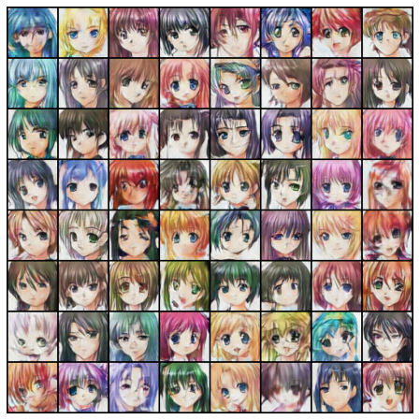
Inter-model Comparison
50 epoch with full dataset
100 epoch with shrinked dataset (19000 images)
Notes:
We train the model on the smaller dataset with 100 epochs.
We see that, the increasing number of epochs cannot compensate for the effect resulted from the lack of training samples, leading to lower quality of result

Slide 13
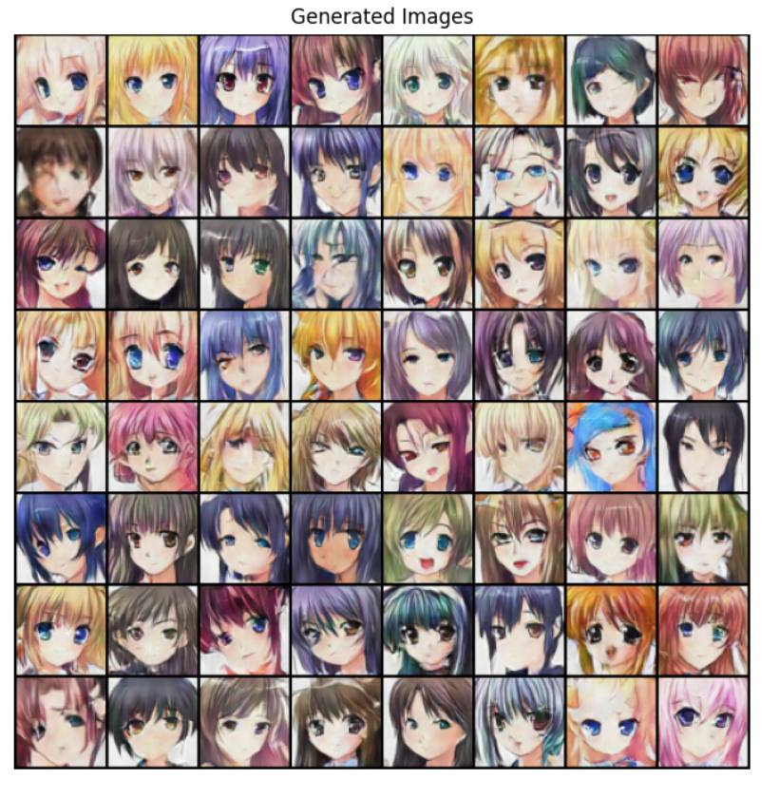
Features Learned from DCGAN
Gender
Hair style
Eye Color/Shape
Clothing style
Mouth
Face contour/orientation
Facial expression

Slide 14
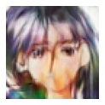
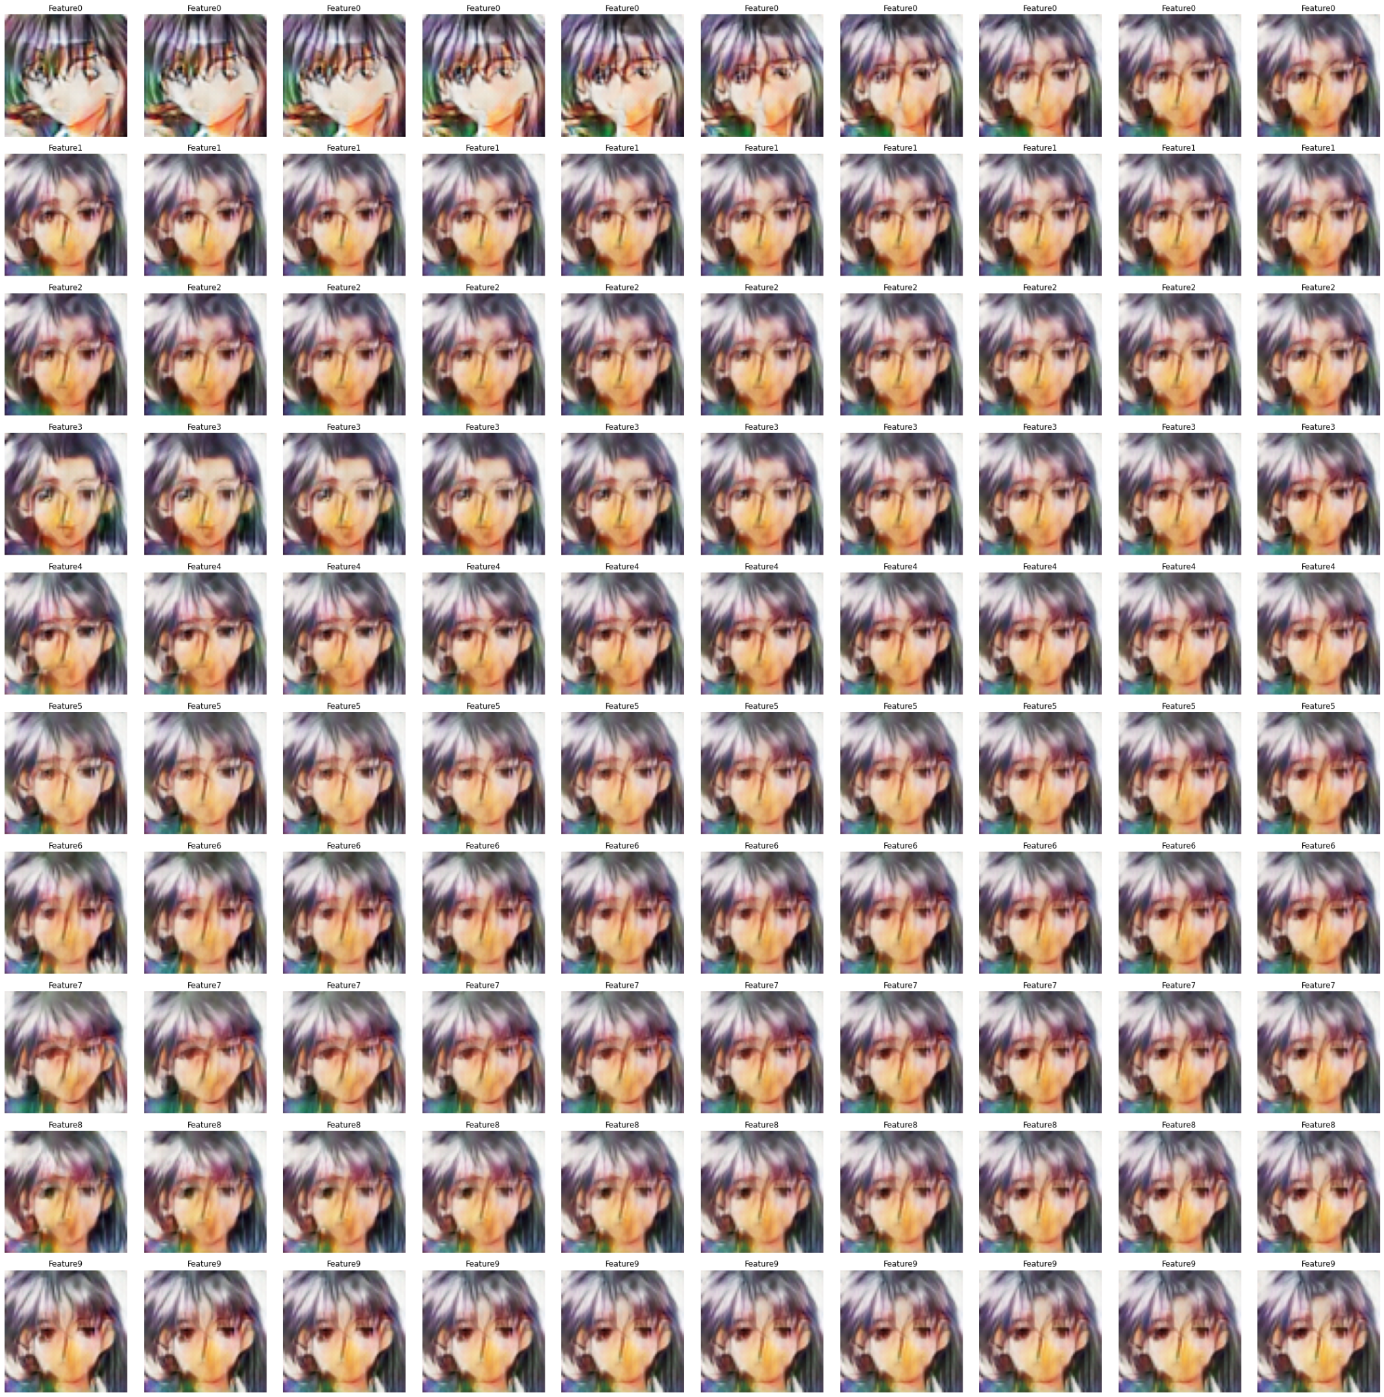
Manipulating a single attribute in Z representation
Selected 10 Z variables (ie. 1st, 10th, 20th…, 90th in the Z representation)
Adjusted them by multiplying them with a manipulation factor K that ranges from -3 to 3.
1st
Original Z
Z
K=-3
K=3
Notes:
To explore to what degree DCGAN learns about these features, we manipulate the input and observe their corresponding synthesis images.

Slide 15
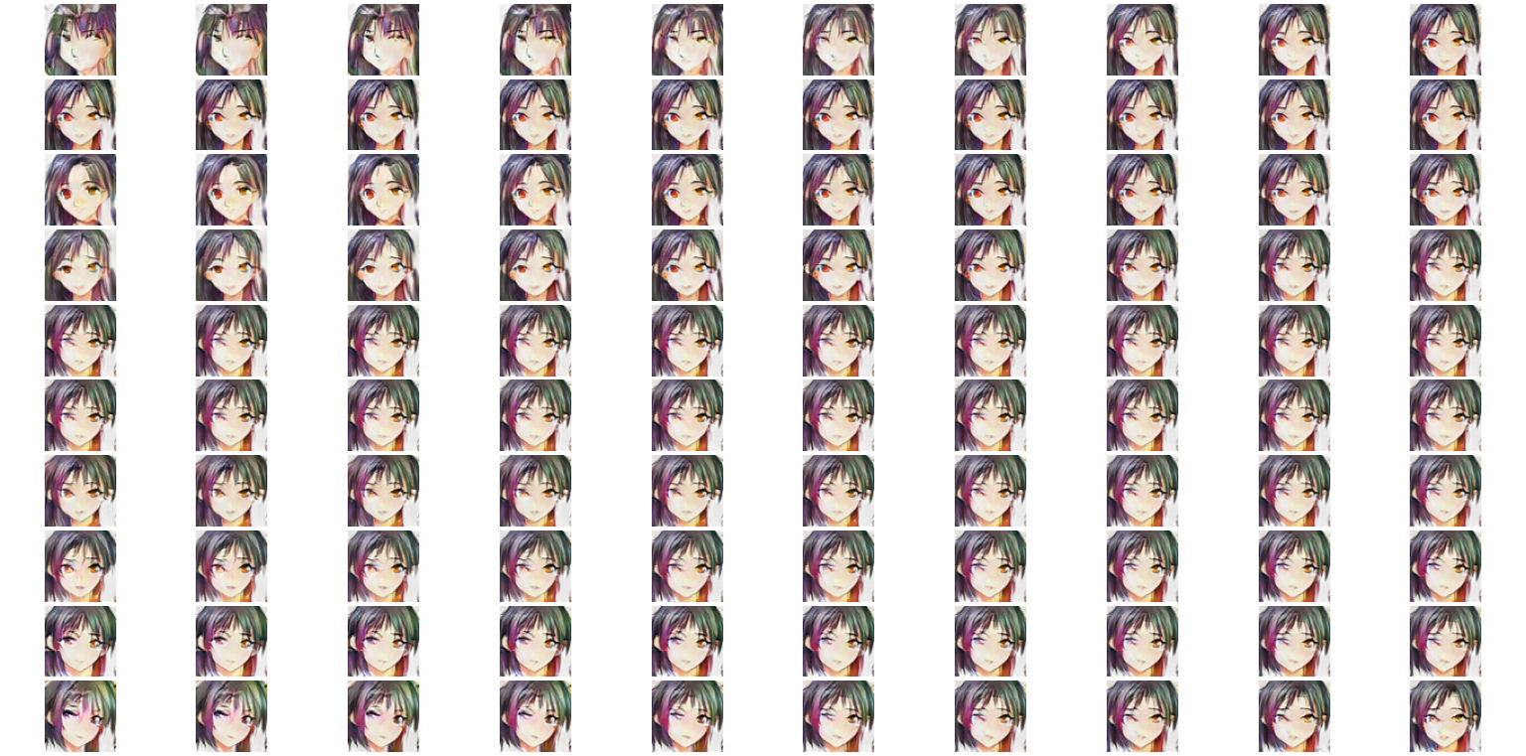
K = -3
K = 3
1st
10th
20th
30th
40th
50th
60th
70th
80th
90th
Notes:
Using this method, we can observe the impact of input on the result. For this random input, scaling the 1st variable changes the face contour of the anime character, making the width of the face shrink as K increases. Scaling the 20th variable seems to impact the face orientation.

Slide 16
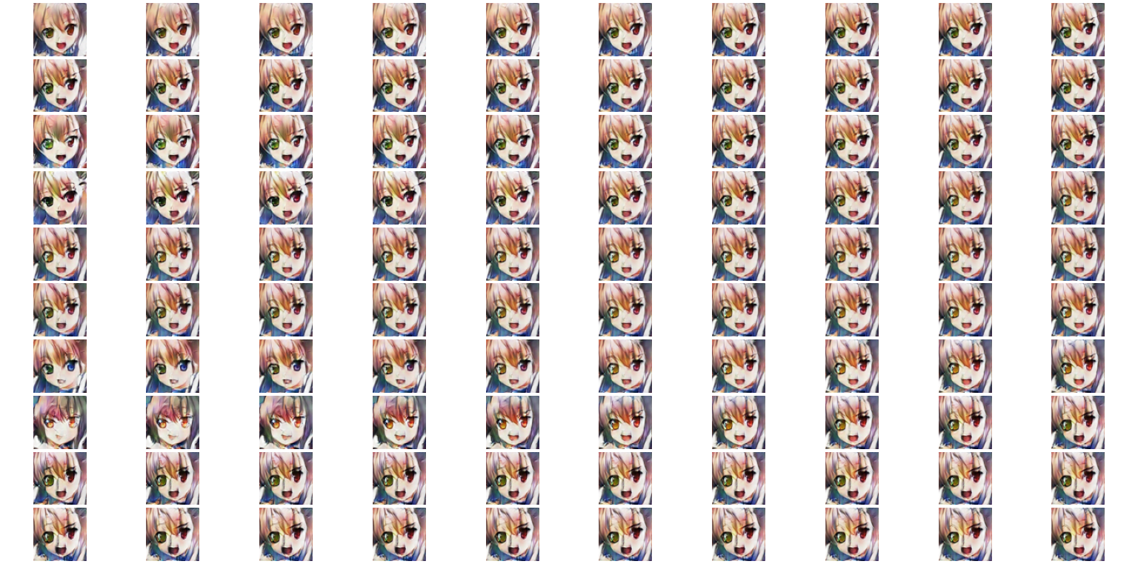
K = -3
K = 3
1st
10th
20th
30th
40th
50th
60th
70th
80th
90th
Notes:
However, we cannot conclude that there is an explicit mapping between the manipulation of a specific Z variable and its impact on image attributes. For example, when we use another input, its 1st variable does not the face contour. Instead, 60th variable seems to do that now.
This effect suggests that DCGAN does not allow specific-control of certain image attributes. However, DCGAN does reveal a potential of learning meaningful attributes and generating images with smoothly transiting features.
##Our results show the limitations of DCGAN that the model cannot explicitly separate the features, adjusting a specific variable in Z representation sometimes lead to changes in multiple attributes and result in a global effect on the synthesized image.

Slide 17
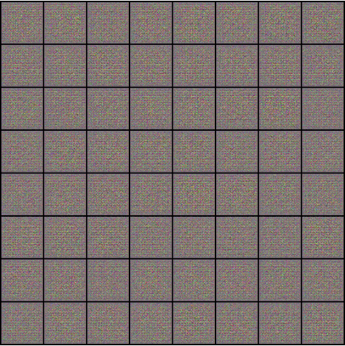
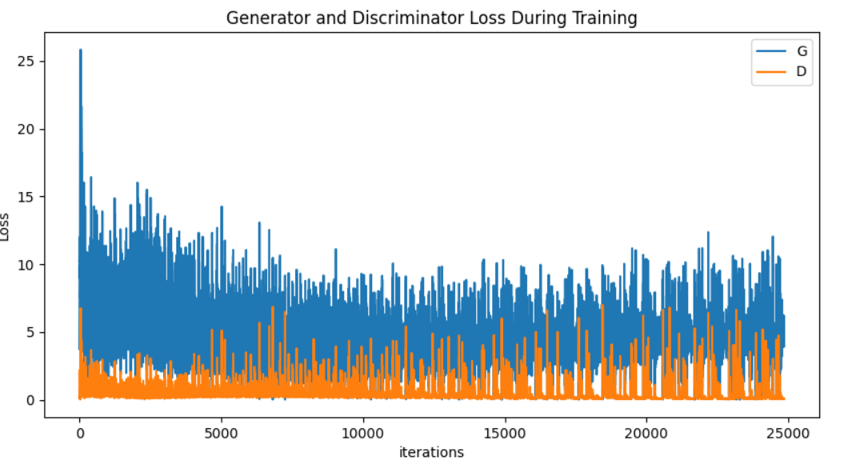
Loss of Generator and Discriminator
Notes:
We observed that The loss of generator is still high after many epochs of trainings, and its always oscillating. However, its range of oscillation becomes relatively smaller towards the end of training. This high loss suggests that the generator still lacks of the ability to produce high quality fake images.
Next, Minh will talk about the styleGAN, which is a more recent generative model and produces better results on this dataset.

Slide 18
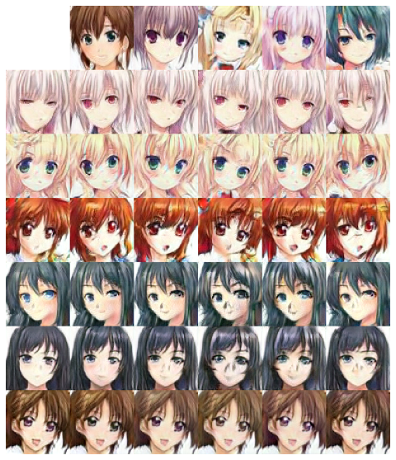
StyleGAN
Notes:
NVIDIA Style Mixing structure

Slide 19
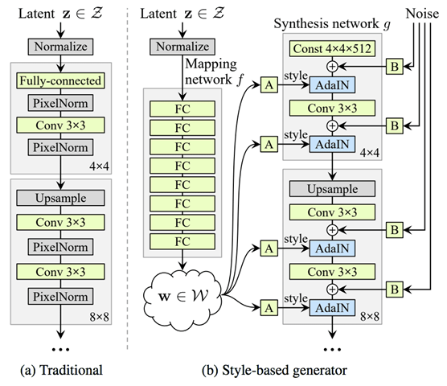
StyleGAN Method and Model
Notes:
Mapping framework
Latent Z vector is processed in the 8 fully connected layer mapping network
Affine Transformation (A) and Adaptive Normalization (AdaIN)
𝐵𝑁(𝑥)=𝛾((𝑥−𝜇(𝑥))/𝜎(𝑥) )+ 𝛽 (batch of images)
𝐼𝑁(𝑥)=𝛾((𝑥_𝑖−𝜇(𝑥_𝑖 ))/𝜎(𝑥_𝑖 ) )+ 𝛽 (one image)
𝐴𝑑𝑎𝐼𝑁(𝑥_𝑖,𝑦)=𝜎(𝑦)((𝑥_𝑖−𝜇(𝑥_𝑖 ))/𝜎(𝑥_𝑖 ) )+𝜇(𝑦), x=input and y=style
𝜇 and 𝜎 are computer per-channel and per sample
Add noise throughout the network (B): localize structures
Mixing Regularization – at least 2, 𝑧_1 𝑎𝑛𝑑 𝑧_2, into 𝑤_1 𝑎𝑛𝑑𝑤_2 (𝑦_𝑠 𝑎𝑛𝑑 𝑦_𝑏)

Slide 20

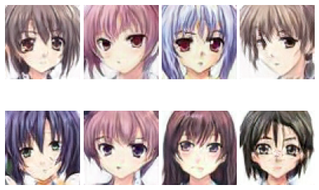
Results and Analysis
Implementation
Controllability
Notes:
Using our newly trained model to generate 4 original images
It’s interesting that the eyes seem relatively consistent while hair and other features changed more drastically.

Slide 21
Implementation
Convert Images to tfrecords
Stores data as a sequence of binary strings
Train Model (9+ hours on Colab Pro)
3500 iterations
Evaluate Model using Fréchet Inception Distance (FID)
Distance between feature vectors calculated for real and generated
39.4008
Image Generation
Style Mixing
Truncation of Ψ
Notes:
Ψ = weights

Slide 22
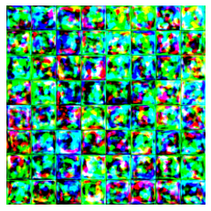
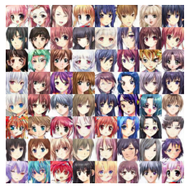
Inter-model Comparison
Genesis
Completion
Notes:
8x8 grid of our training images at genesis and completion
Original model created a 32x32 Grid

Slide 23
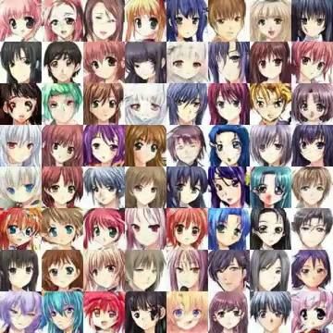
Training Progression
Notes:
8x8 grid time lapse of our training progression

Slide 24
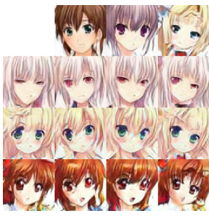
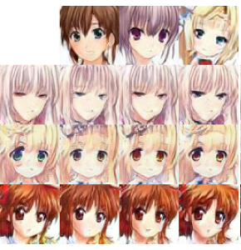
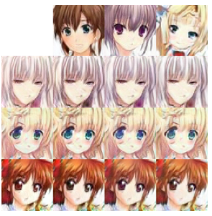
Style Transfer
Coarse Middle Fine
NVIDIA
Notes:
Coarse: face shape, pose, hair, mouth
Middle: eyes (opening/closing), eye color,
Fine: color scheme, subtle changes (shading)

Slide 25
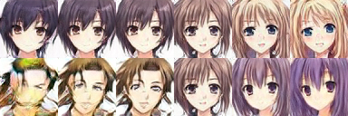
Truncation Trick (Ψ)
Ψ=1 Ψ=0.7 Ψ=0.5 Ψ=0 Ψ=-0.5 Ψ=-1
Notes:
At 0, faces converge to the “mean” face and look the same.
By applying negative scaling to styles, we get the corresponding opposite or “anti-face”
At higher values, gender, hair length, coloring are flipped

Slide 26
Comparison
 | Image Quality | Feature Extraction | Style Transformation
DCGAN | Reasonable Quality with a huge dataset | Coarse features including: Hair color/style, eye position/color, face contour/orientation. Features are probably entangled | No control of style
StyleGAN | High quality but requires more GPU | Coarse: face shape, pose, hair Middle: eyes, mouth Fine: color scheme, subtle changes (shading) | More control over over styles of the images at different levels: coarse, middle and fine
Notes:
Eyes is only for our dataset

Slide 27

Wrap-Up
DCGAN Limitation
Network is relatively inflexible.
Result may not be very satisfactory
Model cannot specifically control image features of the output.
StyleGAN Limitation
Computational power (over 9 hrs for 19000 images)
Lack of pre-trained model for Anime (exist: car, cat, people)
Artifacts creation due to different styles at each level
Wrap-up

Slide 28
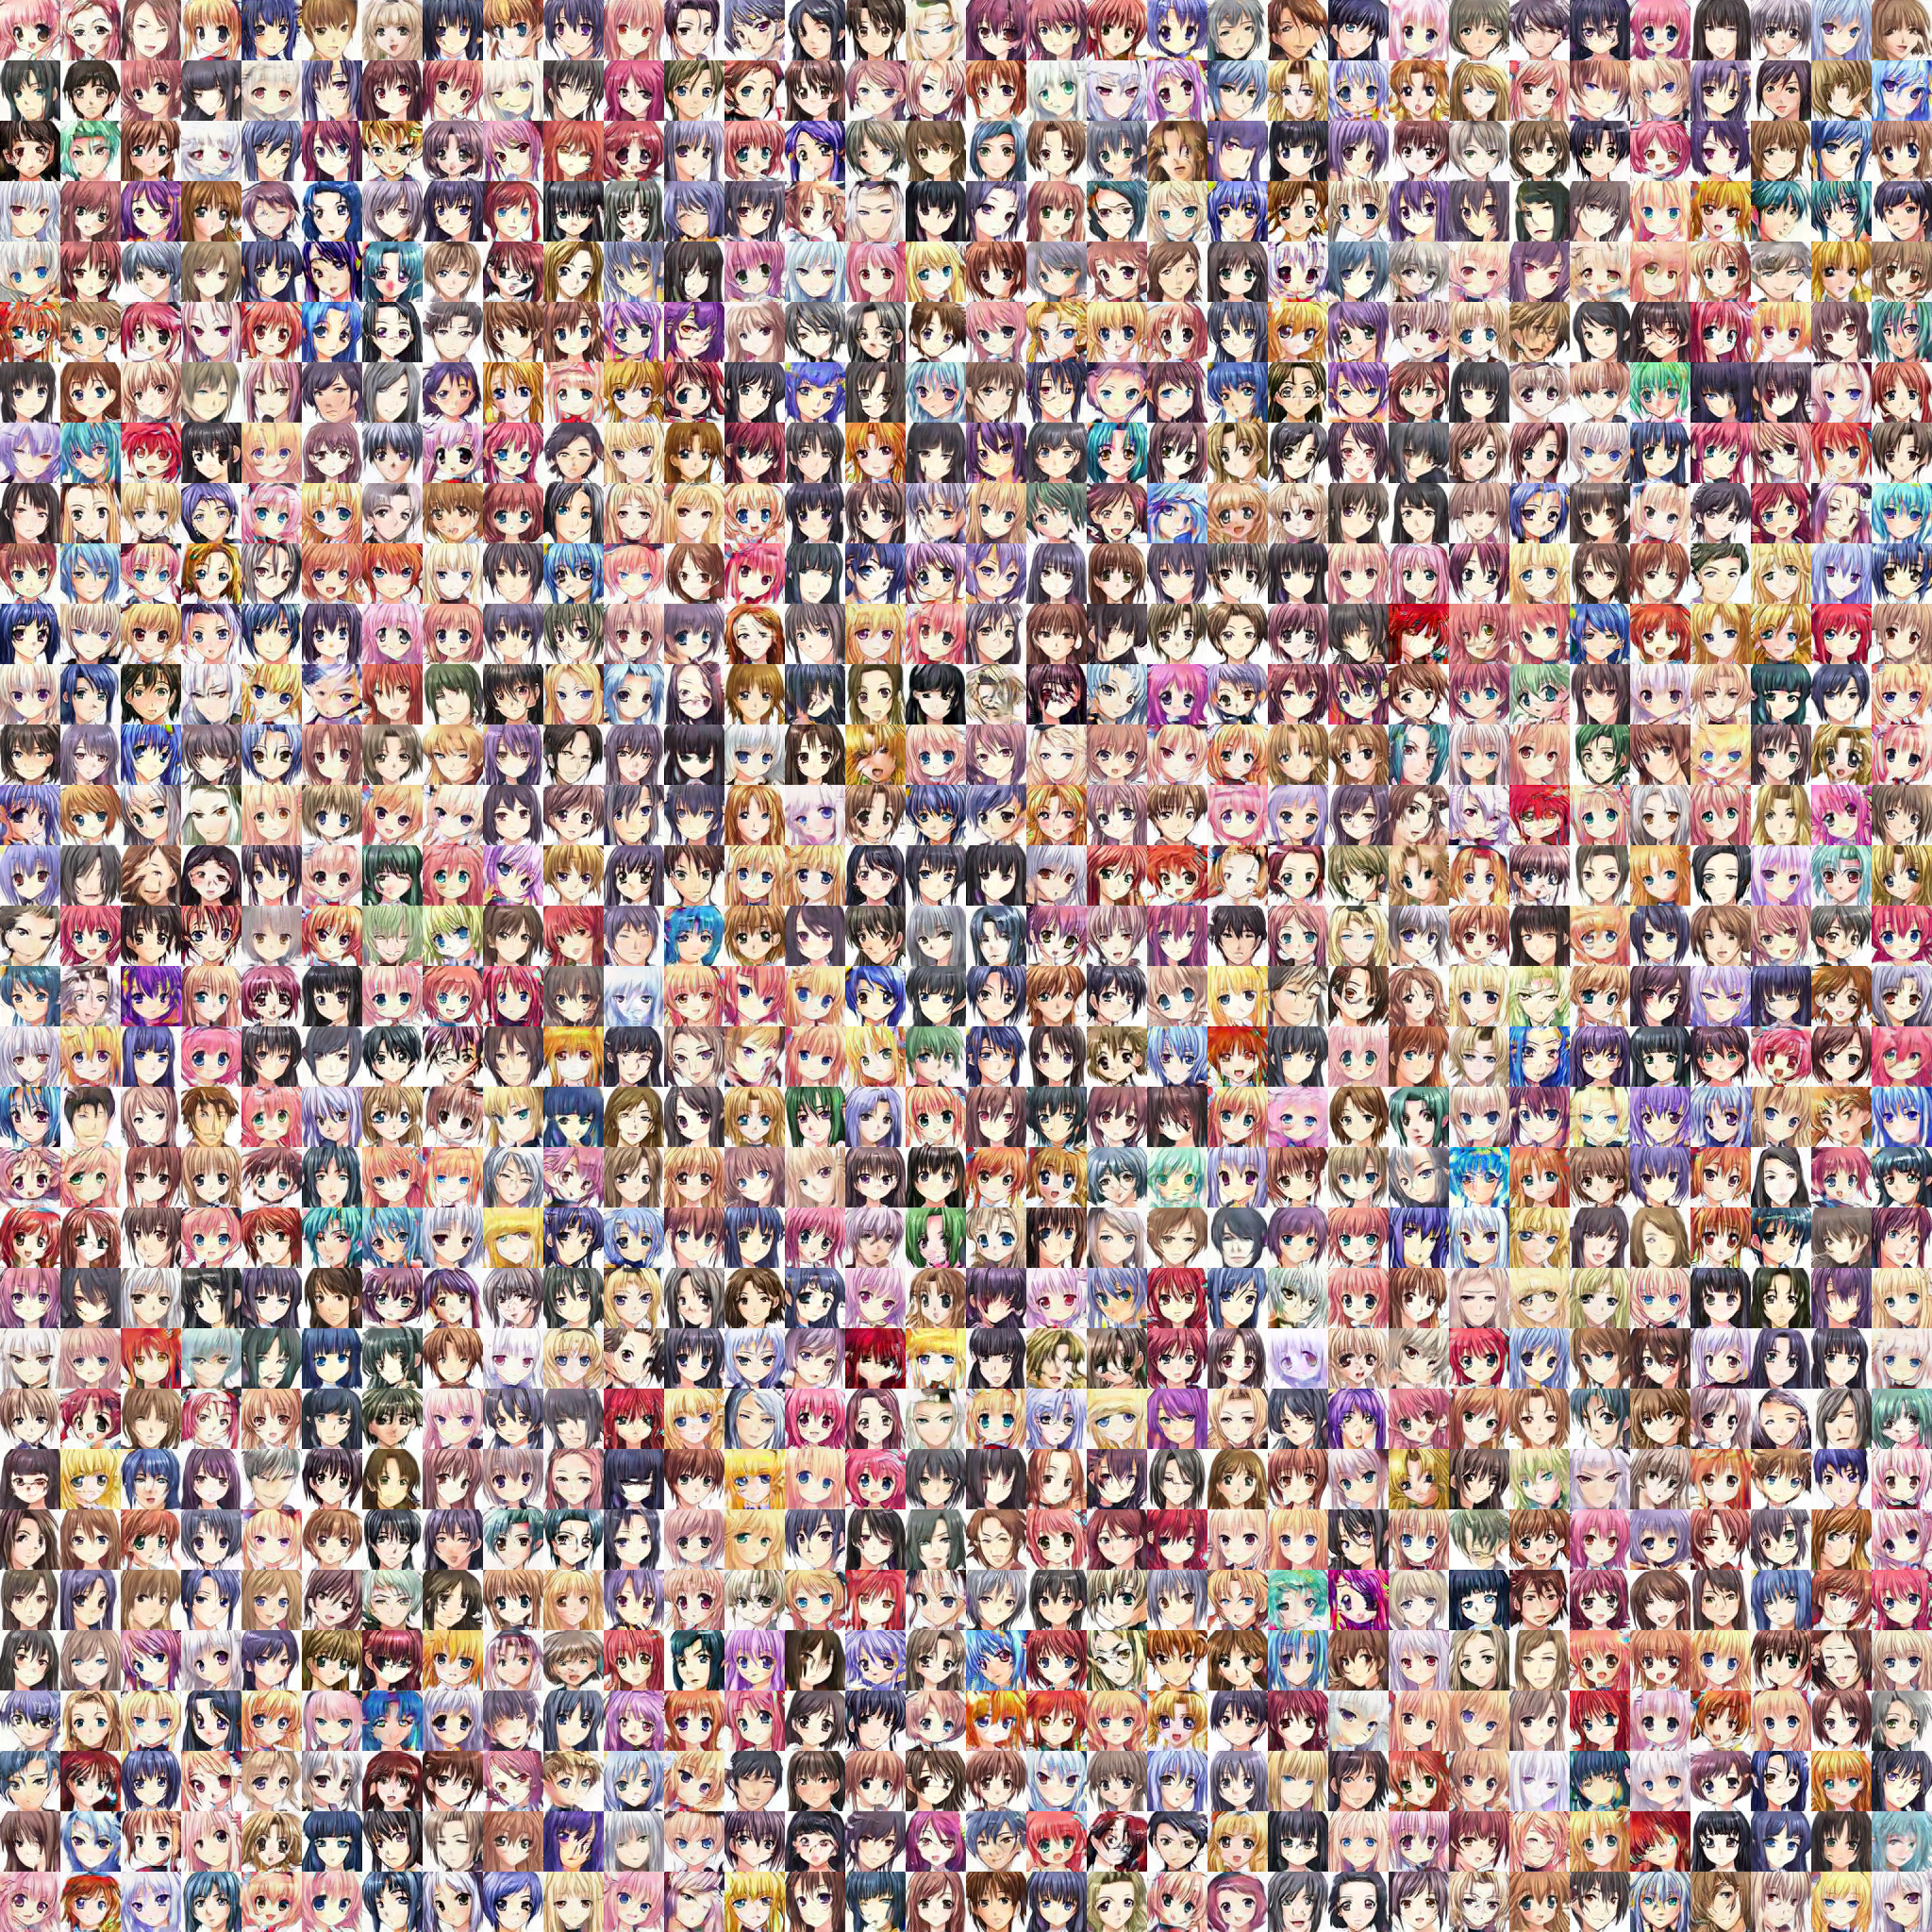
THANK YOU!
Q & A
Notes:
Animation

Slide 29
Appendix - References
NVIDIA – Karras, Laine and Aila, A Style-Based Generator Architecture for Generative Adversarial Networks (2019), https://arxiv.org/abs/1812.04948
NVLabs, StyleGAN — Official TensorFlow Implementation, GitHub, https://github.com/NVlabs/stylegan
Overview of GAN Structure, Google, https://developers.google.com/machine-learning/gan/gan_structure
DCGAN Tutorial, https://pytorch.org/tutorials/beginner/dcgan_faces_tutorial.html
Radford, Metz and Chintala, Unsupervised Representation Learning with Deep Convolutional Generative Adversarial Networks, https://arxiv.org/abs/1511.06434
Goodfellow, et al., Generative Adversarial Networks, https://arxiv.org/abs/1406.2661

